Slide 1

Ministry: Ministry Of Education’s Innovation Cell (MIC)
Problem Statement ID: 1587
Problem Statement Title: Student Innovation
Team Name: Team BS
Description : Disaster Management includes ideas related to risk mitigation and planning before, after or duration of disaster
Institution Name: SRM Institute Of Science And Technology
Theme Name: Disaster Management

Slide 2

DISASTER MANAGEMENT HELPLINE
PROJECT BY TEAM bs
MEMBERS: Abhijeet Khare
Arkadeep chowdhary
Khushi
K Pallavi
Preeti Singh
Spandan

Slide 3
INTRODUCTION
Objective: To develop a comprehensive disaster management website that aids in risk mitigation, preparedness, and response during disasters.
Vision: Create a platform that provides timely information, resources, and tools to help people stay safe and connected before, during, and after a disaster.

Slide 4
Problem Statement
Current Challenges in Disaster Management:
Lack of real-time information and updates during disasters.
Inadequate preparedness and awareness among communities.
Difficulty in locating essential services such as hospitals and emergency shelters.
Lack of a centralized platform for reporting missing people and finding them.
Businesses not having a structured way to offer disaster-specific supplies or services when needed most.

Slide 5
Solution Overview
Our Solution: A user-friendly website that offers crucial information and resources related to disaster preparedness, response, and recovery.
Features:
Precautions to take before a disaster.
Real-time remedies and actions during disasters.
Locating nearby hospitals and shelters.
Providing emergency helpline numbers.
Weather news and updates on ongoing calamities using API integration.
Registration and search feature for missing people.
A platform for businesses to raise tenders and offer disaster-related products or services.

Slide 6
Key Features and Functionalities
Precautions and Preparedness:
Detailed guides on what to do before various types of disasters (earthquakes, floods, etc.).
Checklists for emergency kits, evacuation plans, etc.
During Disaster:
Real-time weather updates and disaster alerts.
Safety tips to follow during the disaster.
Maps and navigation to nearby hospitals, shelters, and safe zones.
Tender:
Marketplace for businesses to submit tenders for disaster-specific Government agencies and NGOs can browse and procure necessary goods or services.
Facilitates private-public collaboration during crises.
Ensures timely availability of critical resources.
Missing Persons Registry:
Form to register missing persons.
Database to search for missing people.
Notification system to alert about found persons.

Slide 7
Technical Implementation
Technology Stack:
Frontend: HTML, CSS, JavaScript, React (or other framework).
Backend: Node.js, (or relevant server-side language).
Database: MySQL, for storing data on missing persons, hospitals, etc.
APIs: Integration with weather and news APIs for real-time updates.
Geolocation: Google Maps API for locating hospitals and safe zones.

Slide 8
API Integrations
Weather and News Updates: Integration with third-party APIs to provide real-time information about weather conditions, disaster news, and warnings.
Geolocation and Navigation: Google Maps API to show nearby hospitals, shelters, and safe routes during emergencies.
Emergency Contacts: Integration with local government databases to provide up-to-date helpline numbers and emergency contacts.

Slide 9
Benefits and Impact
Community Awareness and Preparedness:
Empower individuals with knowledge and tools to handle disasters effectively.
Life-Saving Information:
Quick access to emergency services and guidelines can save lives.
Efficient Rescue Operations:
Centralized information aids in faster and organized rescue efforts.
Reuniting Families:
Missing persons registry helps in finding and reuniting families separated during disasters.

Slide 10
Future Scope
AI and Machine Learning:
Predictive analytics to anticipate disasters and automate emergency responses.
Social Media Integration:
Real-time updates and alerts via social media platforms.
Community Feedback Loop:
User feedback system to continuously improve the platform's features and accuracy.

Slide 11
Challenges and Solutions
Data Accuracy:
Regular updates and validation from trusted sources to ensure reliability.
User Engagement:
Awareness campaigns and partnerships with local authorities to encourage community participation.
Scalability:
Cloud infrastructure to handle high traffic during disaster situations.

Slide 12
Conclusion
Summary:
Our disaster management website will significantly contribute to reducing the impact of disasters through timely information, resources, and a supportive platform for missing persons.
Call to Action:
Let's work together to make our communities safer and more resilient!

Slide 13
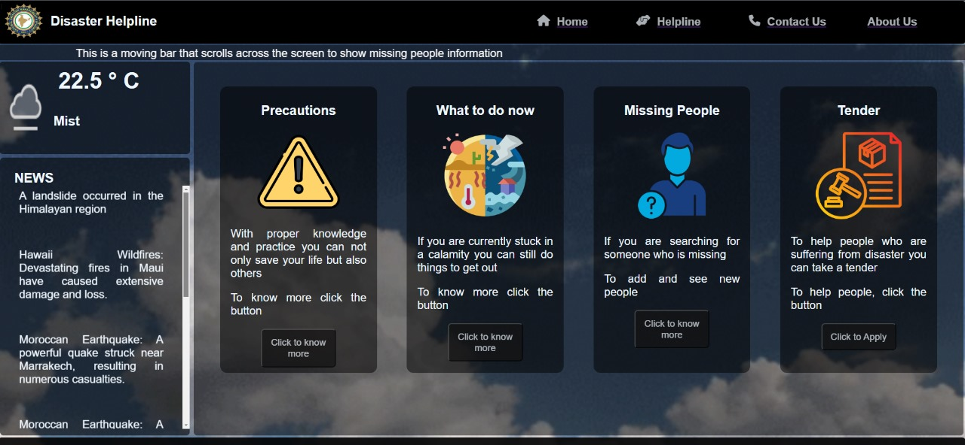
Prototype

Slide 14
THANKYOU

